Slide 1
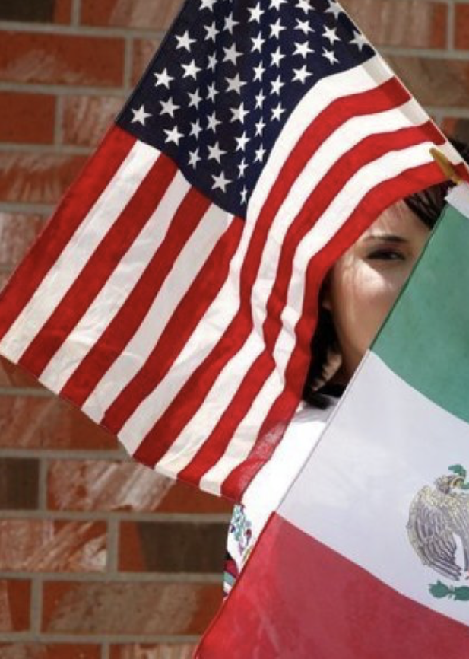
Give Me Your Poor, Your Tired, Your Homeless (Some Restrictions
May Apply):
Immigration to the United States in the 21st Century
Bob Gitter, Ohio Wesleyan
Prof of Econ, Emeritus
National Economic Education Delegation
Johns Hopkins OLLI
Washington, DC
March 18, 2026

Slide 2
Course Schedule
Contemporary Economic Policy Issues
  Week 1 (2/25): Economic Update & Tariffs Geoffrey Woglom, Amherst College
  Week 2 (3/04): An Introduction to Cryptocurrencies, Geoffrey Woglom
  Week 3 (3/11): Saving Social Security, Geoffrey Woglom
  Week 4 (3/18) Economics of Immigration, Robert Gitter, Ohio Wesleyan University
  Week 5 (3/25): Climate Change Economics, Sarah Jacobson, Williams College
  Week 6 (2/27): Health Care Economics, Robert Rebelein, Vassar College

Slide 3
Next week: How Economists Decide How Much to Fight Climate Change: Cost Benefit Analysis
Abating greenhouse gas emissions is costly…
… but without action, climate change damages are even more costly.
Goal is not zero emissions, but efficient level that achieves a balance.
Expected costs of reducing emissions
Expected damages from allowing climate change

Slide 4
SubSubmitting Questions
There will be time for a a Q&A after the presentation
Slides will be available from the NEED website tonight or tomorrow https://needecon.org/delivered_presentations.php.

Slide 5
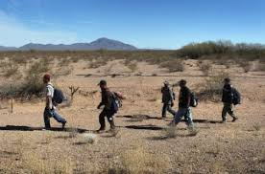
Migration to the US
Difficult to Measure How Many
Legal Immigrants - easy
Undocumented Immigrants
Return Immigrants – no record if return

Slide 6
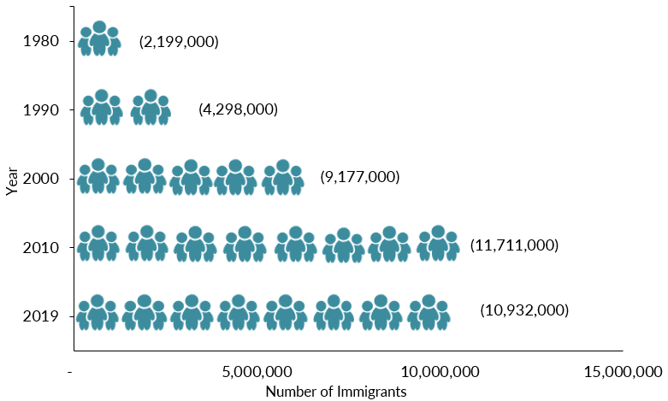
Mexican-Born People in the US
About 10.9 million in 2023 (Latest data)
1 in 14 people born in Mexico currently lives in the US

Slide 7
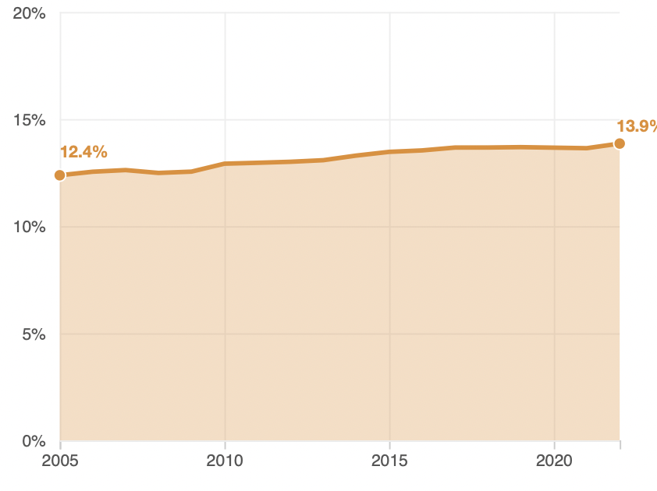
Immigrant Share of US Population
15.8 %
In 2025
12.4 %

Slide 8
Immigrant Share of US Population
12.2 % in Metro Balt.
17.0 % in Maryland
15.8 %
In 2025
12.4 %

Slide 9
The Migration Decision
Benefit of Migrating
Benefit of Staying
Cost of Migrating

Slide 10
Distribution of Income
Mexico
United States
Number of People
Income

Slide 11

The Dangers of Border Crossing

Slide 12
Key Laws
Quota and Immigrations Acts (1921 and 1924)
Bracero Program(1942-1964)
Immigration and Nationality Act (1965)
Immigration and Control Act (1986)

Slide 13
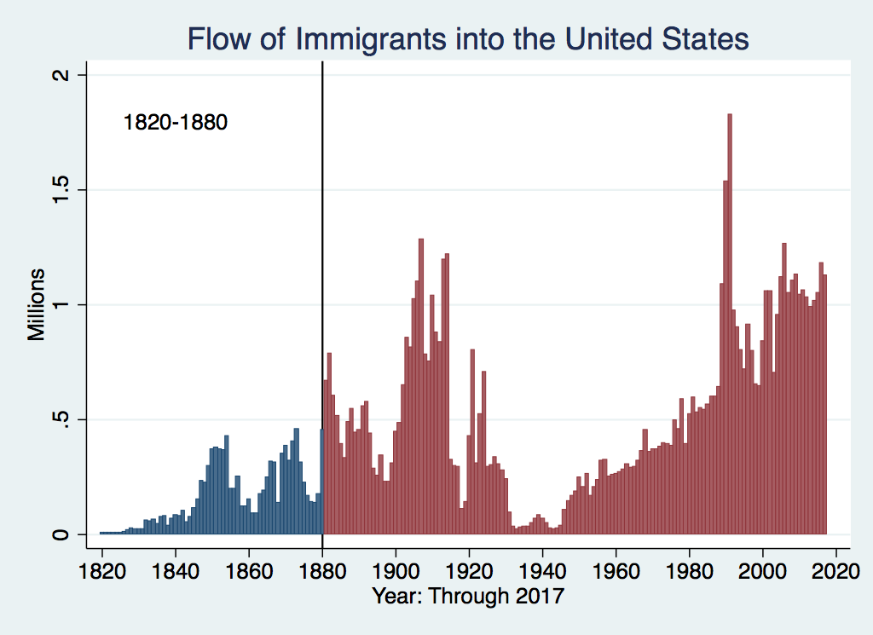
U.S. Immigration 1820-1880
Source Country | 1820-1880
Germany | 3,000,000
Ireland | 2,800,000
Britain | 2,000,000
Austro-Hungarian Empire | 1,000,000
Canada | 750,000
China | 230,000
Africa | 50,000
https://www.libertyellisfoundation.org/immigration-timeline

Slide 14
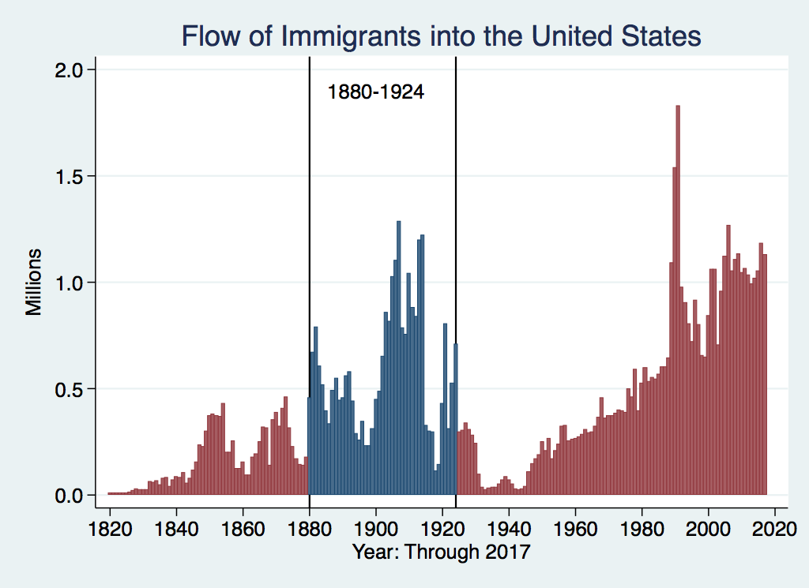
U.S. Immigration 1880-1924
Source Country | 1880-1930
Italy | 4,600,000
Austro-Hungarian Empire | 4,000,000
Russian Empire | 3,300,000
German Empire | 2,800,000
Britain | 2,300,000
Canada | 2,300,000
Ireland | 1,700,000

Slide 15
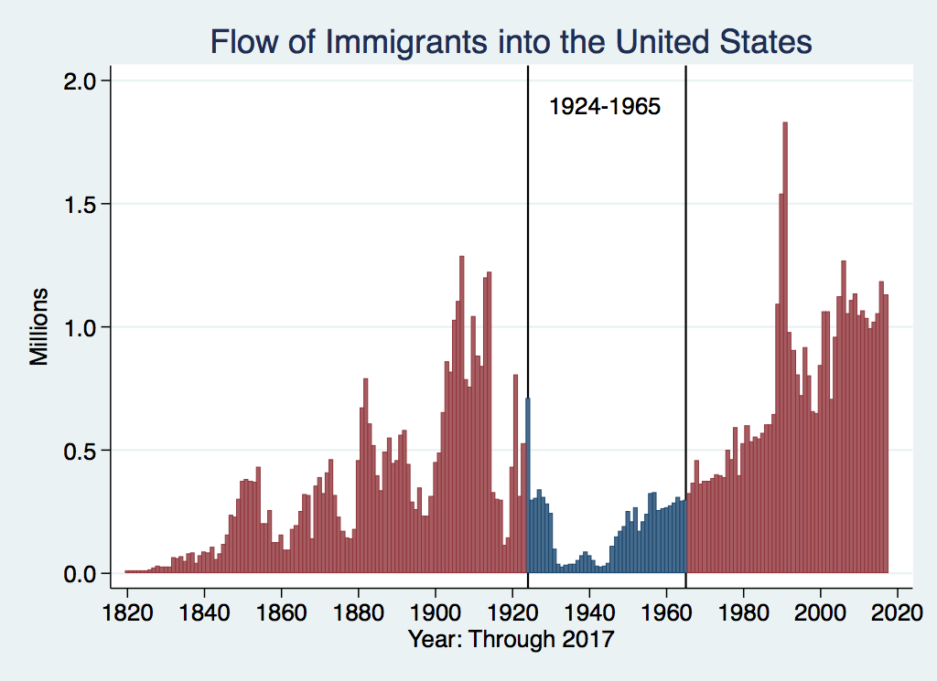
U.S. Immigration 1924-1965
Source Country | 1930-1965
Germany | 940,000
Canada | 900,000
Mexico | 610,000
Britain | 480,000
Italy | 390,000
Caribbean/ West Indies | 310,000
https://www.libertyellisfoundation.org/immigration-timeline

Slide 16
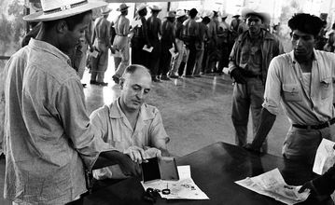
Signing up for Bracero Program

Slide 17
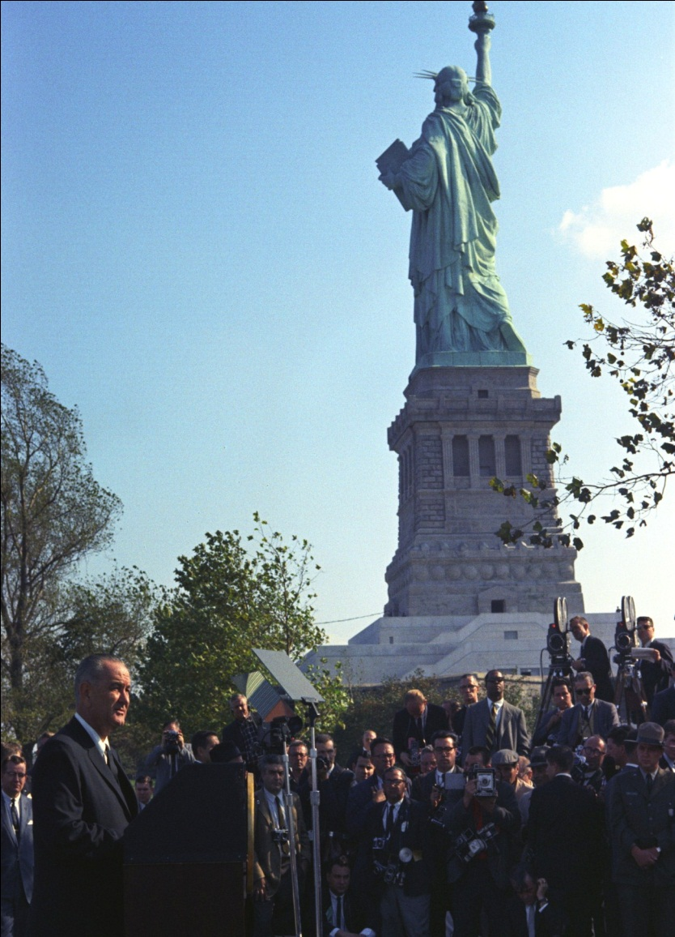
LBJ Signs Immigration and Nationality Act (1965)
Abolished Quotas
Limits immigration to about 1 million/year
Family reunification most important consideration

Slide 18
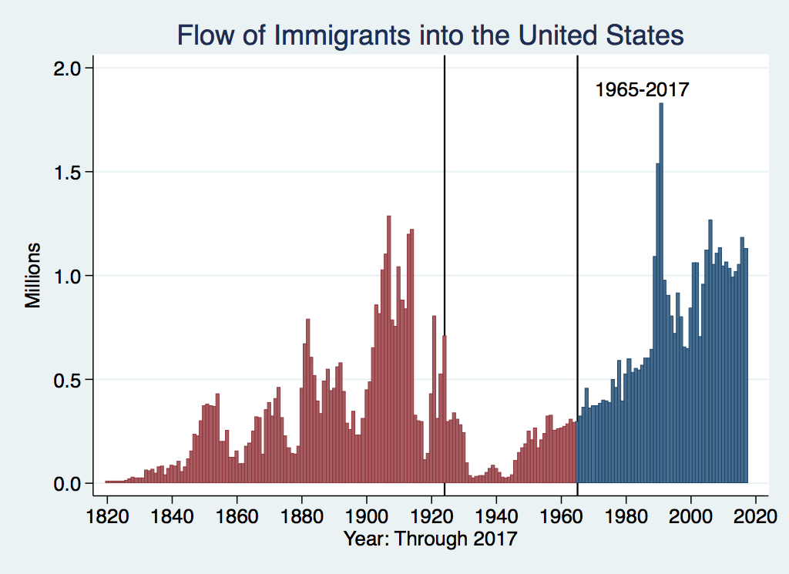
History of U.S. Immigration: 1965-Today
Source Country | 1965-2017
Mexico | 4,300,000
Philippines | 1,400,000
Korea | 760,000
Dominican Republic | 750,000
India | 740,000
Cuba | 700,000
Vietnam | 700,000
Canada | 650,000
https://www.libertyellisfoundation.org/immigration-timeline

Slide 19
NUMBER OF IMMIGRANTS BY TYPE OF ADMISSION: FISCAL YEAR 2023
Family-sponsored preferences | 204,240
Immediate relatives of U.S. citizens | 551,590
Employment-based preferences³ | 196,760
Diversity | 67,350
Refugees | 59,030
Asylees | 40,330
Other | 53,610
TOTAL | 1,172,910
{
755,830

Slide 20
H1B Four Times as Many H1B Applications as Visas Awarded

Slide 21
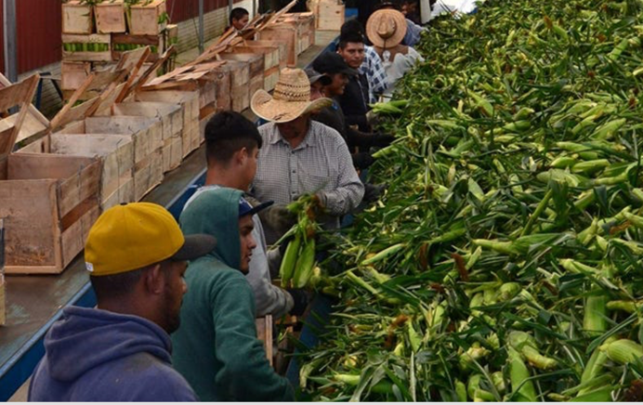
H2A Program

Slide 22
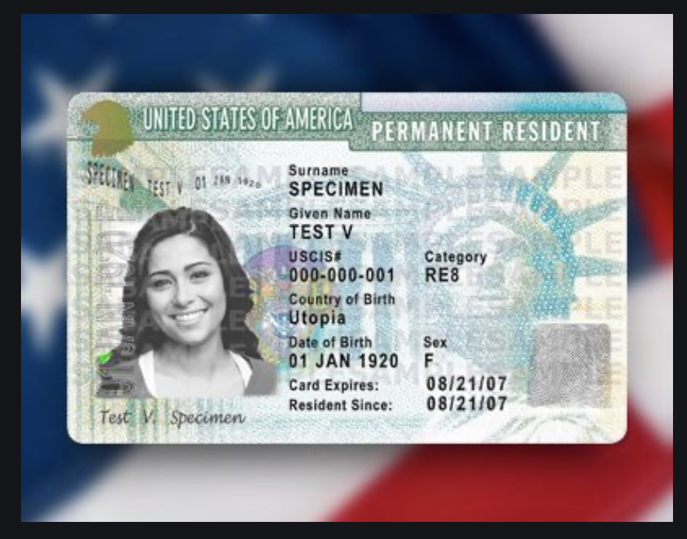
Immigration Reform and Control
Act of 1986
Grants amnesty to undocumented individuals in US since 1982
Must pay penalty and back taxes
Amnesty granted for being undocumented
Path to citizenship
Two million people took advantage, mostly Mexican
Illegal to knowingly hire undocumented workers
Green Card

Slide 23
Immigrant Share of US Workforce
2024 19.1 % immigrant share of Workforce

Slide 24
Immigration to Maryland
Immigrants tend to be of working age. More so than the U.S. Born
Age | Foreign Born | United States Born
0-15 | 6.0% | 22.2%
16-64 | 78.0% | 60.3%
65+ | 16.1 % | 17.5%

Slide 25
Immigration to Maryland
Country of Origin | Percent of Immigrants
El Salvador | 13.4 %
India | 5.7 %
Nigeria | 5.1 %
Guatemala | 4.5 %
China | 4.1 %

Slide 26
Immigration to Maryland
There is a higher share of immigrants without a high school diploma
Education Level | Foreign Born Population | U.S. Born Population
Less than High School | 19.8 % | 5.9 %
High School & Some College | 36.3% | 50.3 %
Bachelor’s Degree | 20.2 % | 23.0 %
Graduate Degree | 23.7 % | 20.8 %

Slide 27
Immigration to Maryland
Top with Highest Share of Immigrant Workers
Occupation | Share of Workers Immigrants
Construction | 62.4 %
Maid & Housekeeper Cleaner | 60.8 %
Other Life Scientists | 58.9 %
Taxi Drivers | 57.4 %
Carpenters | 54.4 %
 | 11.0 %
 | 7.7 %
Chin | 5.1 %
Philippines | 3.1 %
Canada | 2.5 %

Slide 28
Characteristics of Native and Latin Amer. Born Population (Age 16 & up - U S)
 | Native Born | Foreign Born | Lat. Amer. Born
Labor Force | 136 Mil. | 32.3 Mil | 15.7 Mil
< H.S. Educ | 5.3 % | 21.2 % | 32.9 %
Poor English | 2% | 21 % | 33 %
Employed | 59.3 % | 63.7 % | 65.4 %
Unem. Rate | 4.0% | 4.2 % | 4.7%
Med. Wk. Earn | $1,190 | $1001 | $997
Poverty Rate | 12 % | 14 % | 17%

Slide 29
Impact of Latin American Immigration
More likely to be in low-skill, low-wage jobs.
Competition for less skilled native-born
More GDP & lower prices
Helps upper income native-born, hurts lower
Little impact on federal budget but raises costs for state and local (schooling)

Slide 30
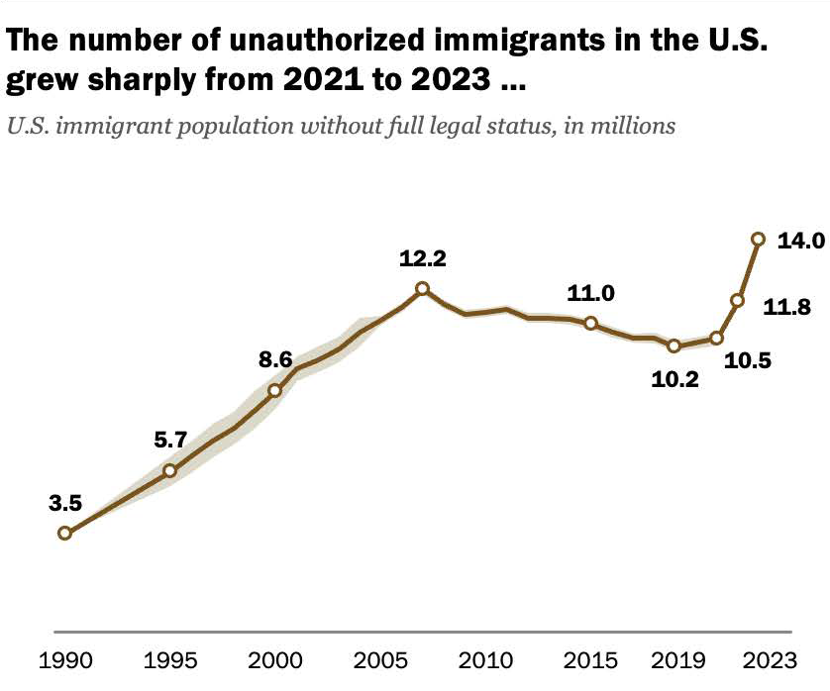
Undocumented Immigrants in the U S
The Pew Foundation estimates undocumented immigrants dropped in 2024 and 2025
Source: PEW Foundation.

Slide 31
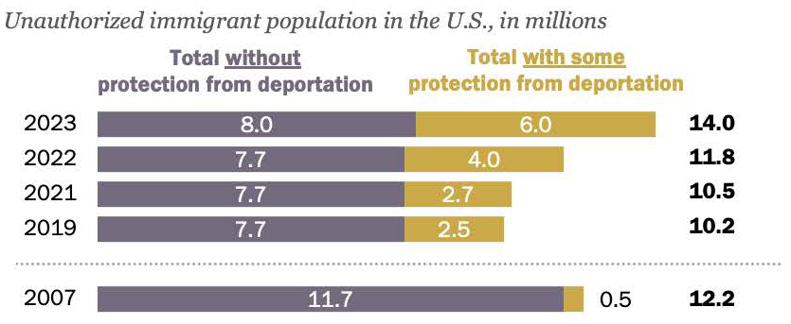
Undocumented Immigrants and TPS
Source: Pew Foundation

Slide 32
Asylees and Refugees
Refugees are usually outside the United States when they are screened for resettlement in US
Asylum seekers submit their applications while physically present in the United States or at a U.S. port of entry
Reason to grant – (US & UNCOR) unable to return because of persecution or a well-founded fear of persecution based on: race, religion, nationality, membership in a particular social group, or political opinion. (Not economic hardship!)

Slide 33
Temporary Protected Status (TPS)
The Secretary of Homeland Security can grant
Can be granted to foreign-born persons who can’t return to home country safely due to their country unable to handle their return
Acceptable reasons
  Conflict - epidemic
  Hurricane or earthquake - Other temporary conditions
Temporary status but can be extended
Can work and travel within the United States
May be eligible for welfare such as TANF, SNAP, Medicaid

Slide 34
TPS As of March 31, 2025
Country | Individuals
Venezuela | 605,015
Haiti | 330,735
El Salvador | 170,125
Ukraine | 101,150
Honduras | 51,225
Other | 39,150
Total | 1,297,635

Slide 35
TPS As of March 2026
Country | Individuals - 2025 Totals
Venezuela | 605,015
Haiti ??? | 330,735
El Salvador | 170,125
Ukraine | 101,150
Honduras | 51,225
Other | 39,150
Total | 1,297,635

Slide 36
Current TPS Status
In Effect | Ended but Suspended by Court Order
El Salvador | Burma
Lebanon | Ethiopia
Sudan | Haiti
Ukraine | Somalia
Yemen | South Sudan
 | Syria

Slide 37
DACA (Deferred Action for
Childhood Arrivals)
Entered U.S. before age 16, now in U.S.
Entered before June 2007
Currently in school, high school grad or honorable discharge from military
No felony conviction or threat to security
Renewable every 2 years
Executive Order by Obama, Trump ended, Biden restored, in court now
About 530,000 in US and 14,000 in DMV

Slide 38
Presdent Trump Day 1 Executive Orders
Massive Expansion of Expedited Removal
Targeting "Recent" Entrants
Expansion of 287(g) Agreements
Targeting "Sanctuary Cities
"Catch and Revoke" Program
Expansion of Detention Infrastructure

Slide 39
Other Recent Changes
Proposed Revocation of Birthright Citizenship
Operation Metro Surge & Other Targeted Cities
Workplace & Campus Raids
The One Big Beautiful Bill Act
Alien Enemies Act of 1798
Expedited Removal Expansion
International "Third-Country" Agreements
Elimination of "Sensitive Zones”
$100,000 Fee for H1B Visa

Slide 40
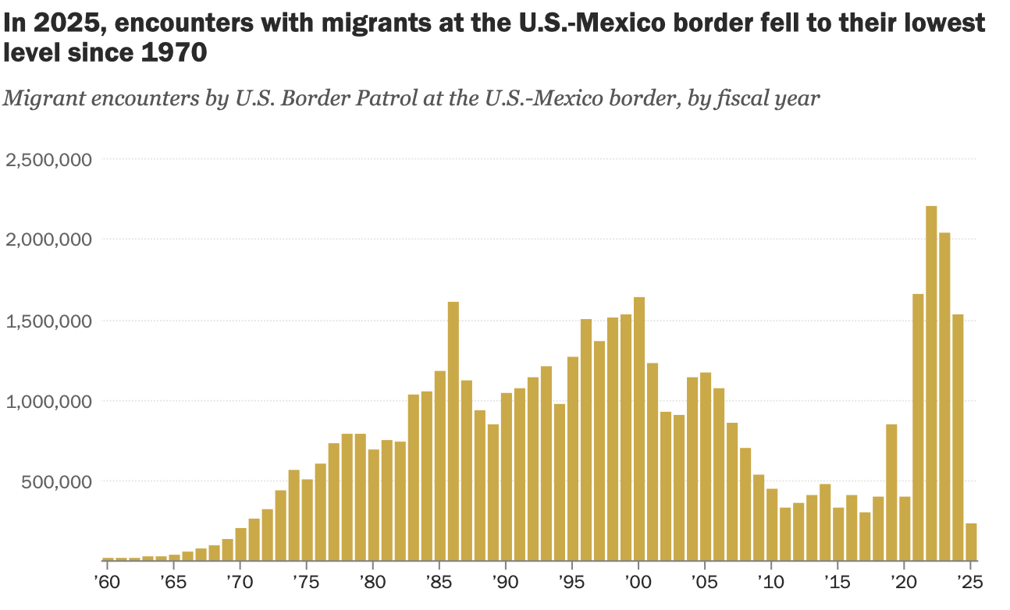
Border Encounters at U.S.-Mexico Border

Slide 41
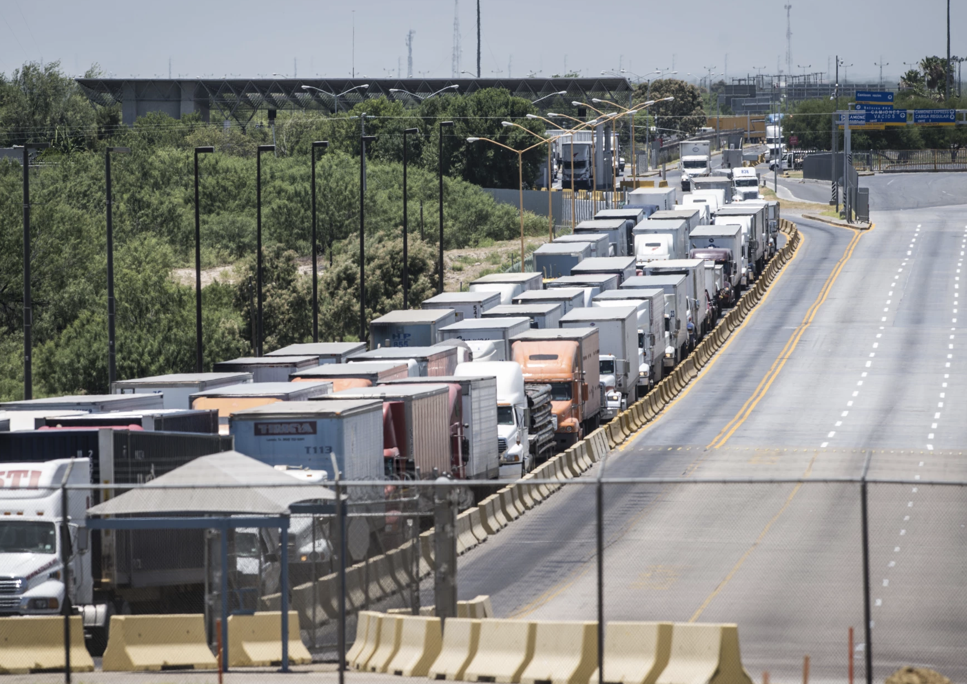
Final Thoughts
Building a wall might not be effective
Going through the dessert is dangerous
Illegal to hire undocumented workers but still done
Undocumented are not eligible for welfare
Maybe a points system like Canada

Slide 42
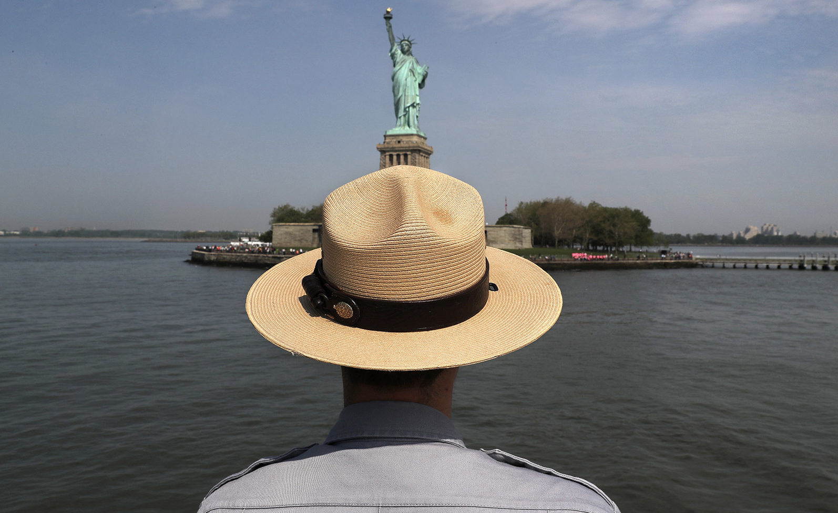
Thank you!
Questions?
Robert Gitter
rjgitter@owu.edu
Contact NEED: info@NEEDEcon.org
Submit a testimonial: www.NEEDEcon.org/testimonials.php
Become a Friend of NEED: www.NEEDEcon.org/friend.php

